Slide 1





Slide 2
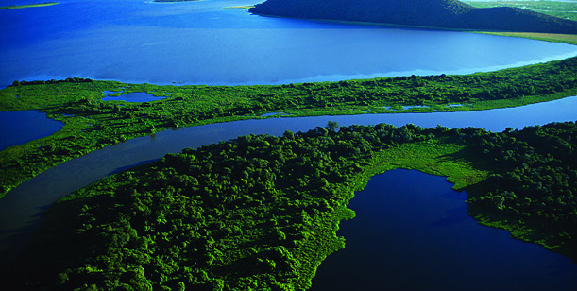
Blue Gold
Which commodity, if you owned it all, would allow you to rule the world…?

Slide 3
Water is a finite resource.
There are NO substitutes..!!!
1) 69.3 gallons per day per US resident
2) Only 2% of all water is freshwater
3) All the lakes around Mexico City have dried and it is now
sinking into the cavernous remains of its reservoirs
4) California runs out of water in 20 years
5) New Mexico runs out of water in 10 years
6) Ga tried to expand it’s border into Tn to secure water

Slide 4
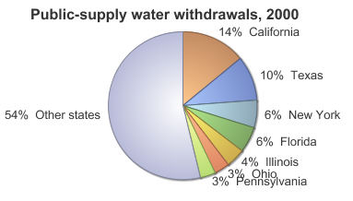

Slide 5
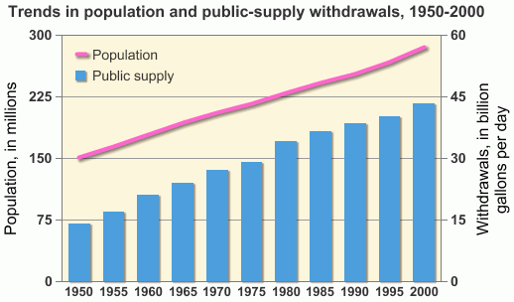

Slide 6
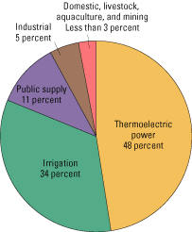
Top
Water Consumers
Thermoelectric Power
by far the largest
Irrigation for crop
production is next
The supply of potable
water to the public is
third

Slide 7
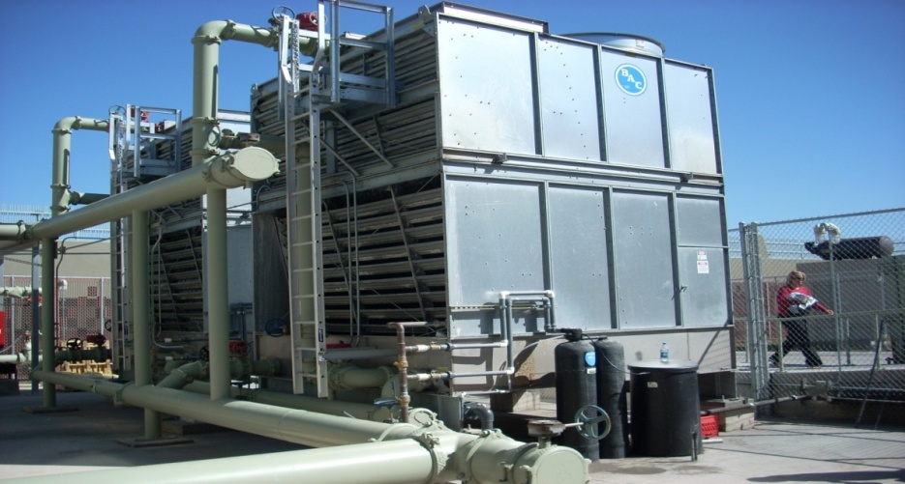
Public Supply %11
Cooling Tower water use typically accounts for 10 to 45% of
a facility’s total potable water consumption.
In Florida it can be as much as 75% of total water
consumption in a commercial building.
A typical 350,000 SF building can consume 8 million
gallons of water annually.
  Of that, 6 million gallons consumed by HVAC and up to 50% of that is wasted via bleed off.

Slide 8

Cooling Tower Bleed Off
Up to 50% HVAC water use is dumped down your building’s drain every year.
Thousands of dollars are going with it.

Slide 9
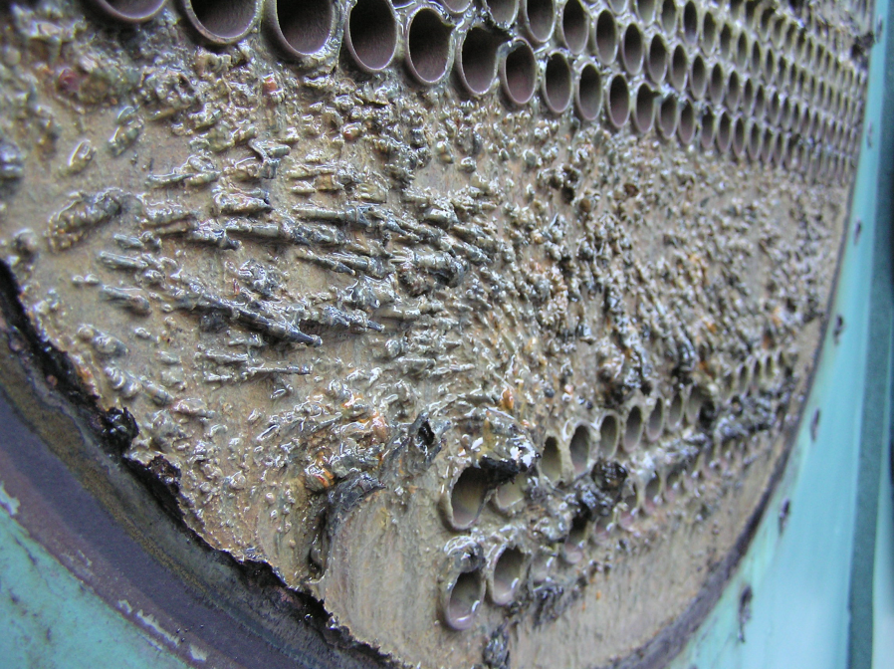
Proper Water Treatment
  Protects equipment
  Extends equipment life
  Minimizes water and energy costs

Slide 10
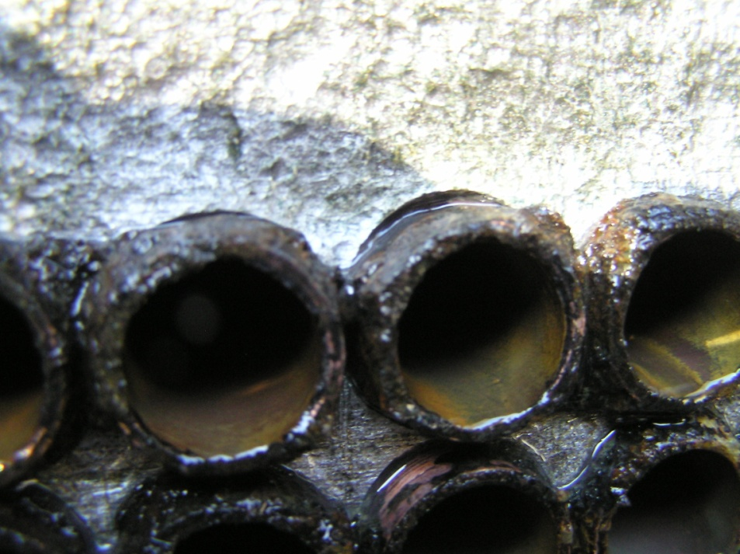
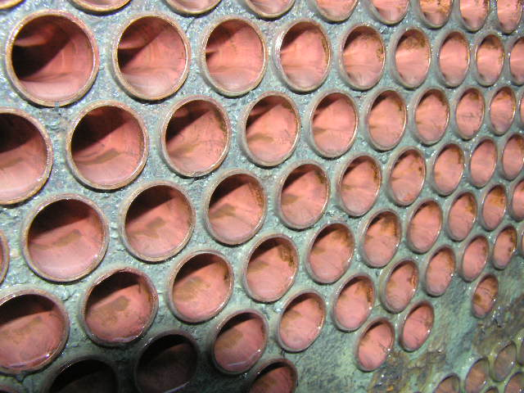
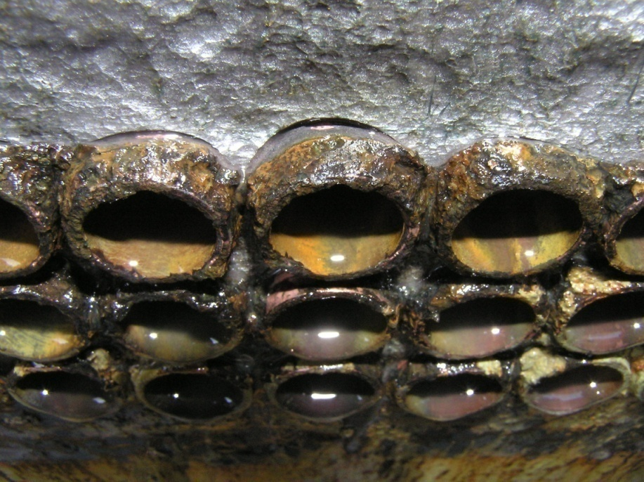
Results of Improper Water Treatment
.

Slide 11
ZeroTek
CG Solution’s High CyclesTower Treatment Program

Slide 12
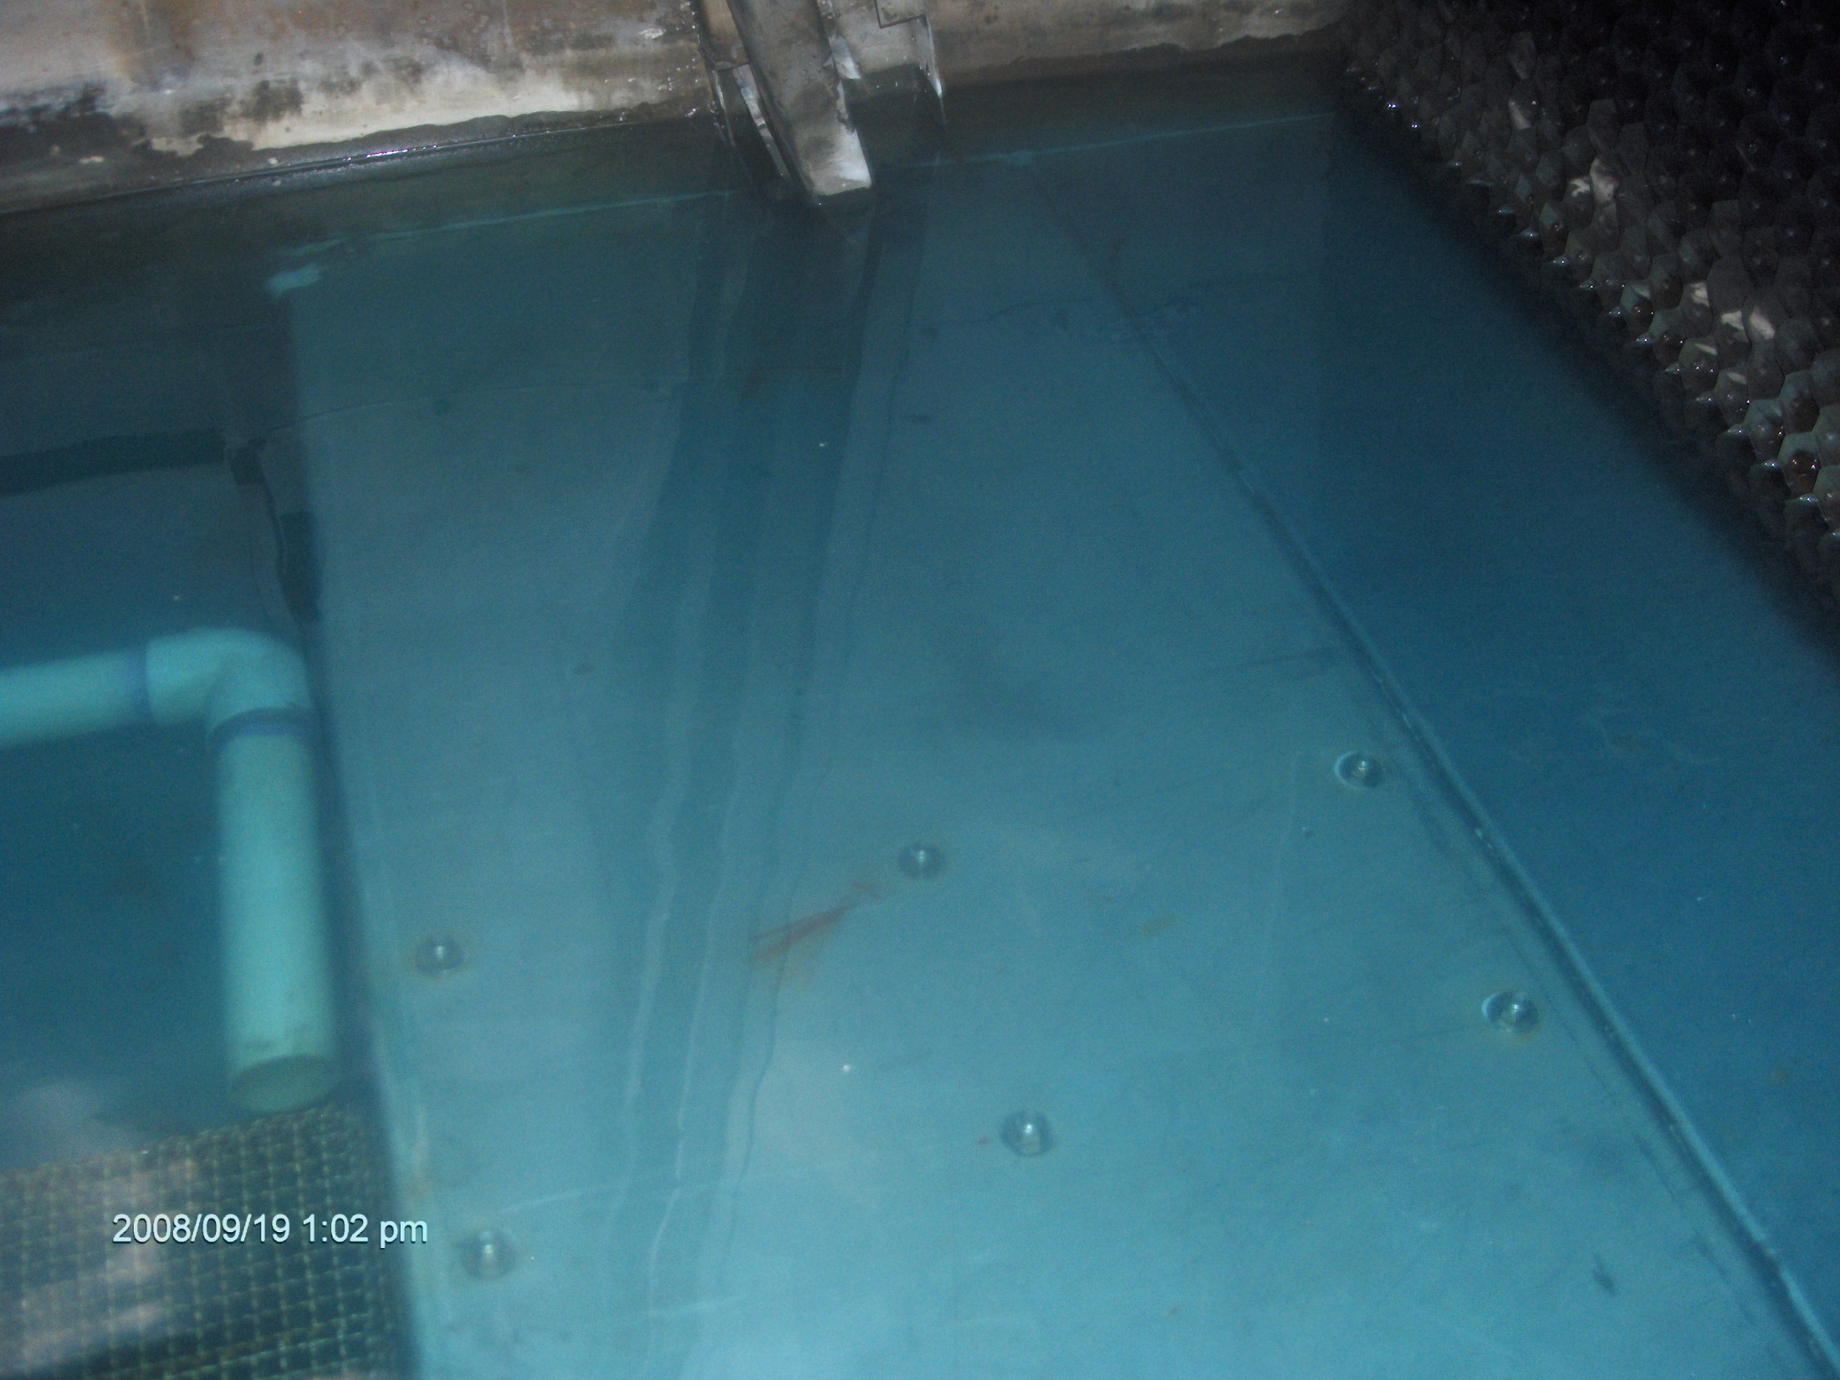
A “Green” Water Treatment Management Program

Slide 13
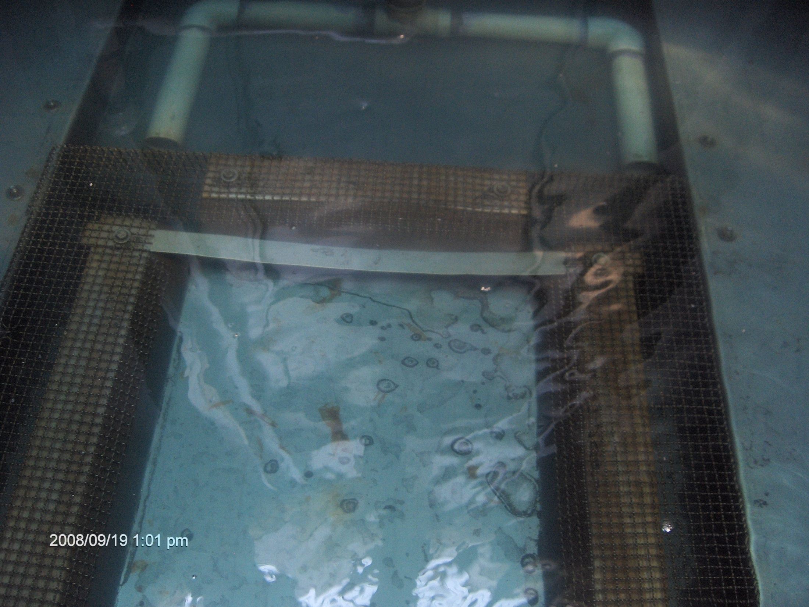

Slide 14
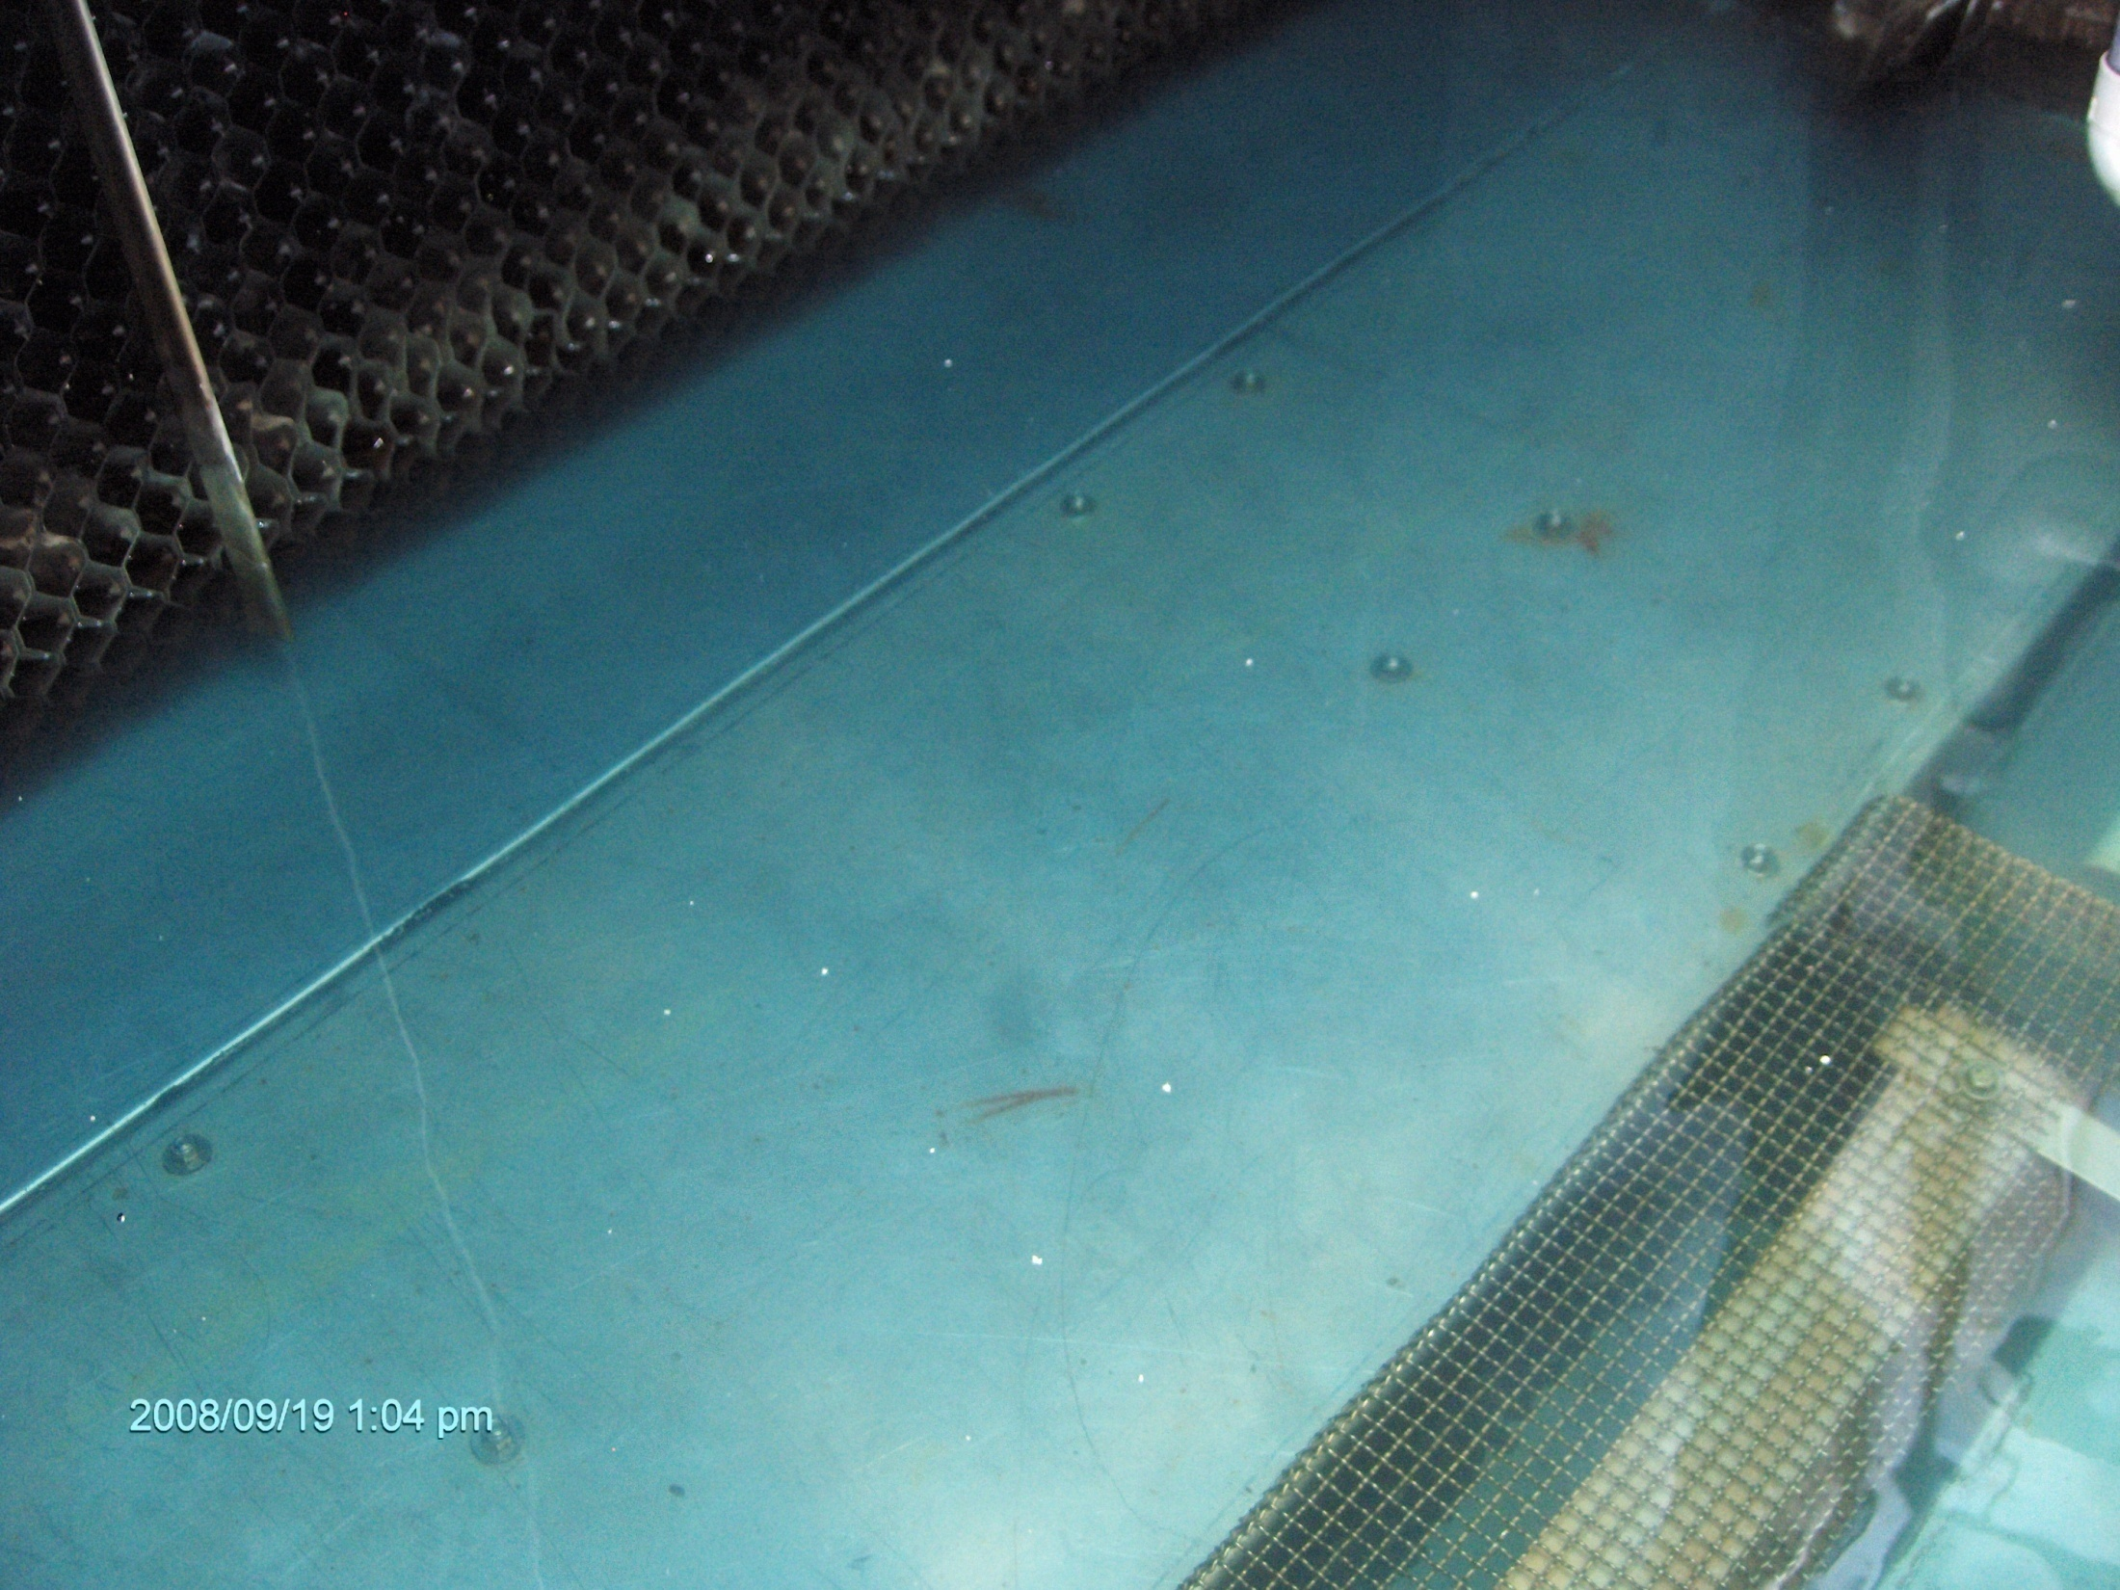

Slide 15
What is
ZeroTek?
Water softener
Multi-media water filter
Patented Green Chemistry

Slide 16
From Traditional To ZeroTek
With our patented chemistry, ZeroTek allows you to TURN OFF the bleed line and SAVE the water going down your drain.
Amazing amount of SAVINGS in water, energy and $$$.
No Scale formation. Any scale present is Dissolved away.
Returns system to Manufacturer’s Original Specifications as a result of scale removal.
Huge energy savings on scaled systems.
Corrosion rates are as good or BETTER than what you are currently experiencing.
System is totally AUTOMATED, for low or no labor hours.
Adds Points For USGBC LEED Building Certification.

Slide 17
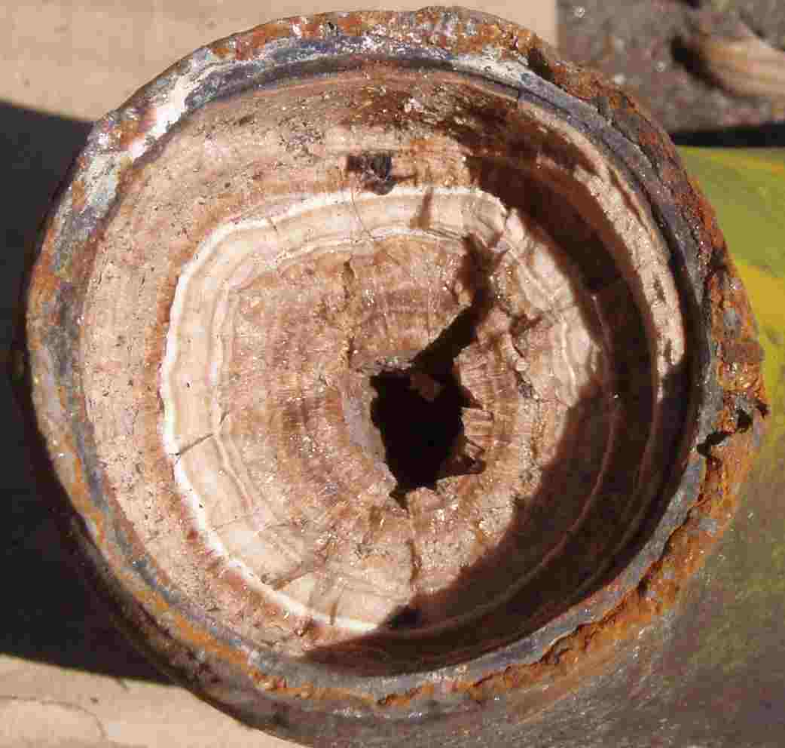
Efficiency
COST OF SCALE
28
24
Increase in Power Costs
20
Based on 100 ton unit
Operating 10 hours per day
25 days per month
16
% Increase
in Power
Cost
12
8
4
0
.02
.04
.06
.08
.10
.12
.14
.16
.18
Scale Thickness - Inches

Slide 18
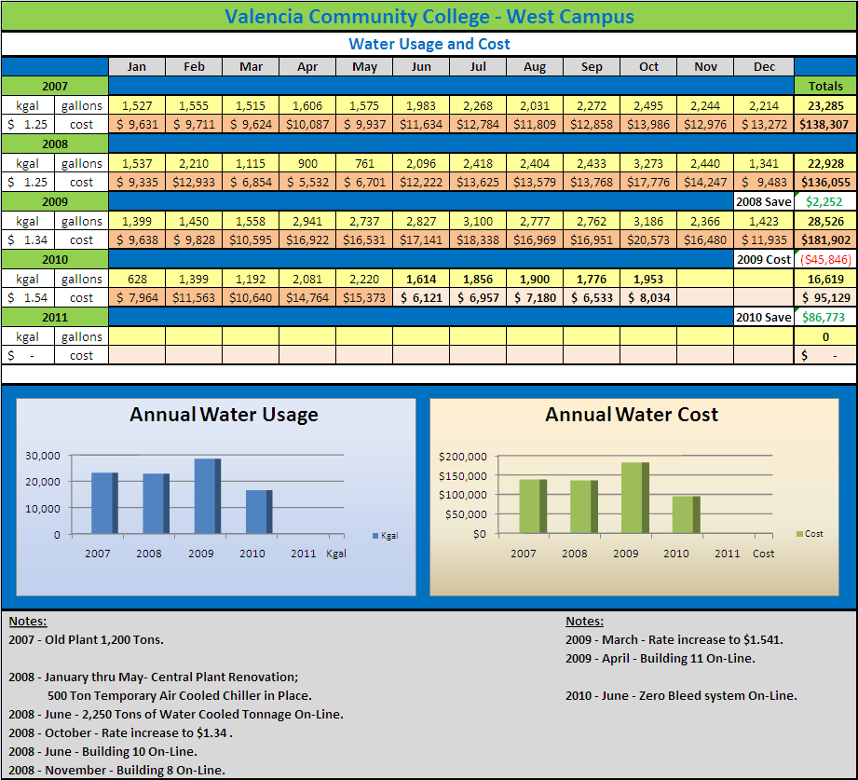
Water Cost Savings
Profile
2007 water cost is
$1.25.
2007 campus is
operating on 1200 tons.
2010 water cost is
$1.54.
2010 campus is
operating on 2250 tons.
Less water is being
consumed in June 2010
than June 2007.
Dollar Savings of
$5,500 June 2010 over
June 2007.

Slide 19
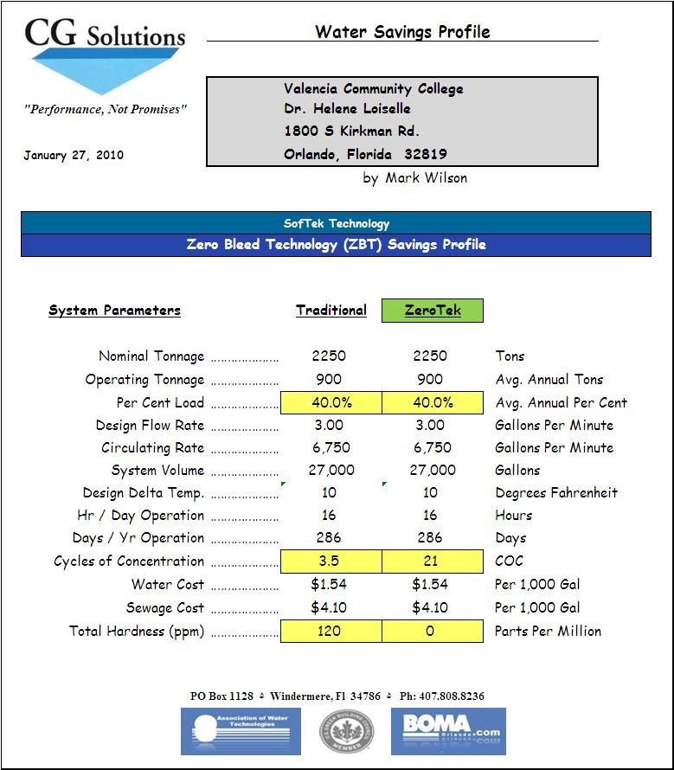
Water Cost Savings
Profile
2,250 Tons of Cooling
operating at 40% per
year = 900 Tons
24 hours per day
7 days per week
From 3.5 cycles of
concentration to 21
cycles of
concentration
120 ppm of Total
Hardness to 0 ppm

Slide 20
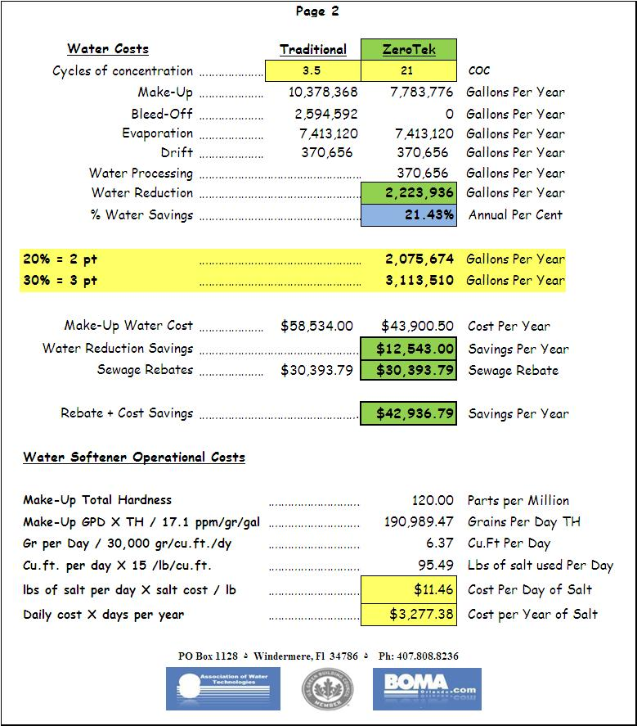
Water Cost Savings
Profile
2.2 million gallons of
water saved from the
bleed line drain
Amount of Evaporated
Water remains the
same
370,000 gallons for
processing ZeroTek
equipment
2 points for USGBC
LEED certification
$12 salt cost per day

Slide 21
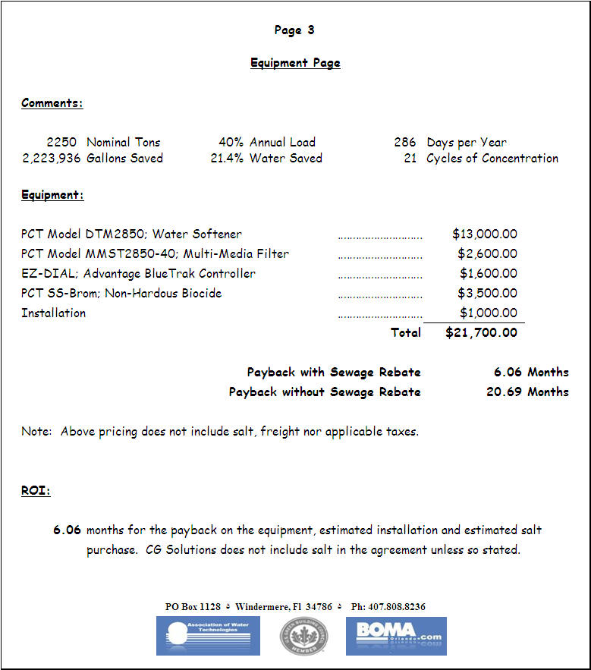
Water Cost Savings
Profile
Water reduction
savings $12,500
Sewage Rebate savings
$30,500
Annual water savings
$43,000
Estimated one-time
equipment cost $22,000
Return on investment
is less than 7
months.

Slide 22
ZeroTek
Liquid Assets

Slide 23
Blue Trak 1
Accurate automatic Chemical
Controller
Works with or without your current
chemical controller
Works in conjunction with ZeroTek
Blue Trace
Utilizes Spectrometer technology to
maintain accurate control settings
Models available for internet and
BAS networks
Candidate for USGBC LEED
Innovation, 1 point for building
certification

Slide 24
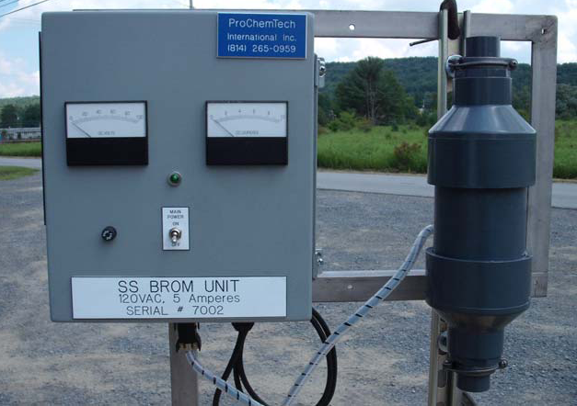
SS-Brom
OSHA Classified as Non Hazardous
Biocide
Electrolytic Bromine
Produces oxidizing biocide
Single Drum Treatment Program
No toxic fumes
No spill hazards
Effective against Algae and
Legionnella
Candidate for USGBC LEED
Innovation, 1 point for building
certification
Drumless Biocide

Slide 25
Biological Fouling
Generic Product Use Costs
Product
Cost
To Determine Biocide dosage Amounts
20 % polyquat
$0.67
98 % hydantoin
$ 0.86
Standard 15 gallons/ton
Cooling Tower
System
20 % DBNPA
$ 1.02
25 % trisnitro
$ 1.98
10 % MBT
$ 1.29
Evaporative 2 gallons/ton
Condenser
System
15 % glut
$ 4.67
16 % quat
$0.94
30 % carbamate
$ 0.97
Electrolytic Bromine
$ 0.28
Calculated as $ to treat 1000 gallons of cooling water, based on typical product strength, recommended average dosages, and prices as supplied by ProChemTech
50 % polyquat
$ 2.22
1.5 % iso
$ 3.45
Stabilized bromine BLB-110
$ 0.62

Slide 26
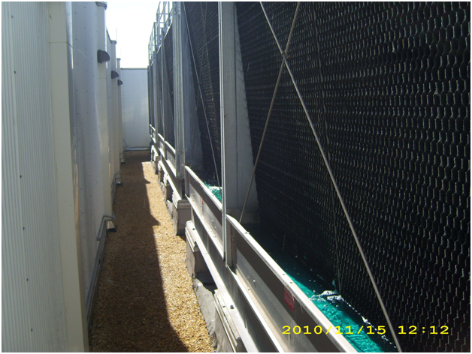
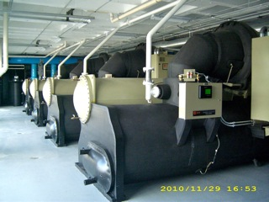
Valencia Community College
West Campus
Electrolytic Bromine
$ 0.28

Slide 27
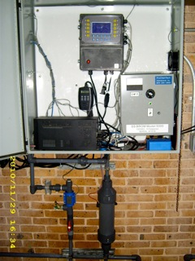
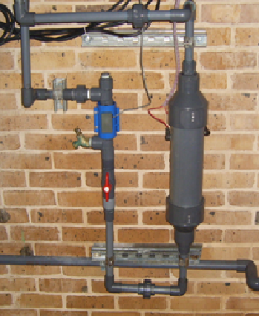
ZeroTek
Equipment

Slide 28
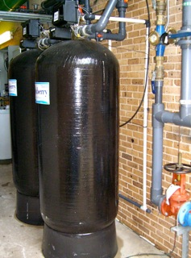
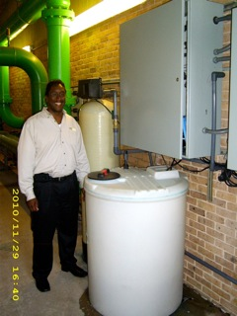
ZeroTek
Equipment

Slide 29
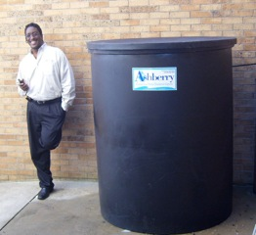
ZeroTek Equipment

Slide 30
ZeroTek
Liquid Assets
Water Softener to remove the total hardness from the make
up to the cooling tower to prevent and remove scale
deposition.
Multi-media filter to “pasteurize” the recirculating
condenser water.
BlueTrak controller to automatically maintain proper
inhibitor levels to prevent system corrosion.
Mini-Brom non-hazardous biocide to prevent biological
fouling.

Slide 32
Thank you for Your Interest in ZeroTek
Formed by a group of highly dedicated, experienced, water treatment professionals in 1986, CG Solutions is emerging as one of the leaders in high cycles technology.
We furnish a complete single source, patented, technology package including water softeners, bypass filters, electrolytic brominators, biocides, and special water treatment chemistry required to operate a cooling system.
CG Solutions manufactures its product line using state of the art technologies, superior consultants and a dedication to quality, providing complete laboratory analysis and expert technical assistance .
Dedicated to delivering superior products and quality equipment, while adhering to the highest ethical standards.
“Performance, Not Promises”

Slide 33

Contact Information
Gale A. Thompson LEED AP
Ph: 407.808.8236 Email: gthompson@cg-solutions.biz
Fx: 800.850.7489 Web: www.cg-solutions.biz

